Slide 1



Finding Scholarships
Where to look and how to win them
2019-20 Academic Year
Notes:
Welcome to Finding Scholarships: Where to look and how to win them.
College can be expensive, but there are billions of dollars in scholarships available to help you reduce your cost. This is money you don’t have to pay back. It’s literally free money you can use to pay for college.
In order to get any of this free money, you need to apply.
Today I’ll show you some online tools you can use to find scholarships that are a good match for you and give you tips on how to win them.

Slide 2




What is a scholarship?
Funds donated by
individuals
corporations
small businesses
churches
community organizations
clubs
colleges
Money that
does not
have to be
paid back
Notes:
Does everyone know what a scholarship is?
[CLICK]
A scholarship is money given to students to pay for education and training.
Funds for scholarships are donated by individuals, corporations, small businesses, churches, community foundations, clubs and colleges.
And most importantly, this is money that does not have to be paid back.

Slide 3












Scholarships are awarded for
Religious
affiliations
  Talents
  Hobbies
  and interests
Artistic
abilities
  Financial
  need
SCHOLARSHIPS
ARE AWARDED
FOR
Environmental
causes
Community
service
Ethnic
background
Athletic
abilities
  Grades and
  test scores
Notes:
Scholarships are available for all kinds of students, interests, abilities, characteristics and skills.
Scholarships are awarded for anything and everything—including:
Hobbies and interests
Talents (writing, spelling bee, etc.)
Grades and test scores
Financial need
Ethnic background
Community service
Religious affiliations
Artistic abilities (art, film, dance, music)
Athletic abilities
Environmental causes
Career plans
Now let’s talk about where you can find scholarships.

Slide 4




LOOK LOCALLY
Check with your church,
service organizations
and community foundations
Contact local businesses, your employer, or your parent’s employer
Check your guidance office
Notes:
Start your scholarship search by looking locally.
You can check with your church, service organizations (like the Kiwanis, Shriners, Rotary or Elks clubs) and community foundations.
Contact local businesses and your or your parents’ employers—many companies offer scholarships to the dependent children of their employees.
If your parents are part of a union at work, that’s a good place to check too.
Another good place to check is your guidance office. Businesses that offer scholarships will sometime provide counselors with information to share with students.
When you start your search locally and find scholarships to apply for, you’ll have a better chance of winning them because you won’t be competing with as many other students as you would with some national scholarships.
I also want to point out that searching for scholarships is something you should make an ongoing commitment to doing. New scholarship opportunities are always becoming available, so you need make sure you are constantly searching and asking about them.

Slide 5


CHECK WITH COLLEGES
Contact the financial aid offices of the colleges you are interested in
Search college websites
Notes:
Another great place to find scholarships is the colleges you are interested in attending.
You can contact the financial aid office, and some even offer lists on their websites.
Many colleges offer quite a few, including opportunities for freshman. New scholarships opportunities are always presenting themselves, so you should check back often.

Slide 6



SEARCH ONLINE
CollegeGreenlight.com
Fastweb.com
Niche.com
Petersons.com
Scholarships.com
Unigo.com
  FREE!
Notes:
Another place to search for scholarships is online.
There are a number of websites that offer FREE help to students with their search.
That is important to note—you should never pay to find or apply for scholarships.
The sites I’m sharing with you today are FREE and reliable. They include:
CollegeGreenlight.com
Fastweb.com
Petersons.com
Niche.com
Scholarships.com
Unigo.com
These sites can help match you with scholarships that you are eligible to apply for.
Let’s take a look at how it works.

Slide 7


FASTWEB
Notes:
Let’s look at fastweb.com.
On the home page they make it very easy to get started. Simply click “start your search”.

Slide 8
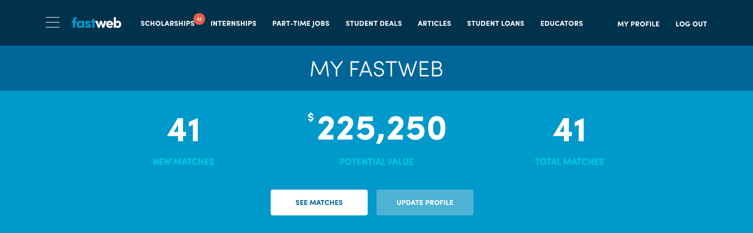
FASTWEB Dashboard
Notes:
One you register for an account and enter some basic information, such as your grade level, birth date, and college level you're looking for scholarships for fastweb will produce a list of scholarships that may be a good match for you. You can see from my example that fastweb found 41 scholarships that are a good match for me with a combined value of $225,250.

Slide 9
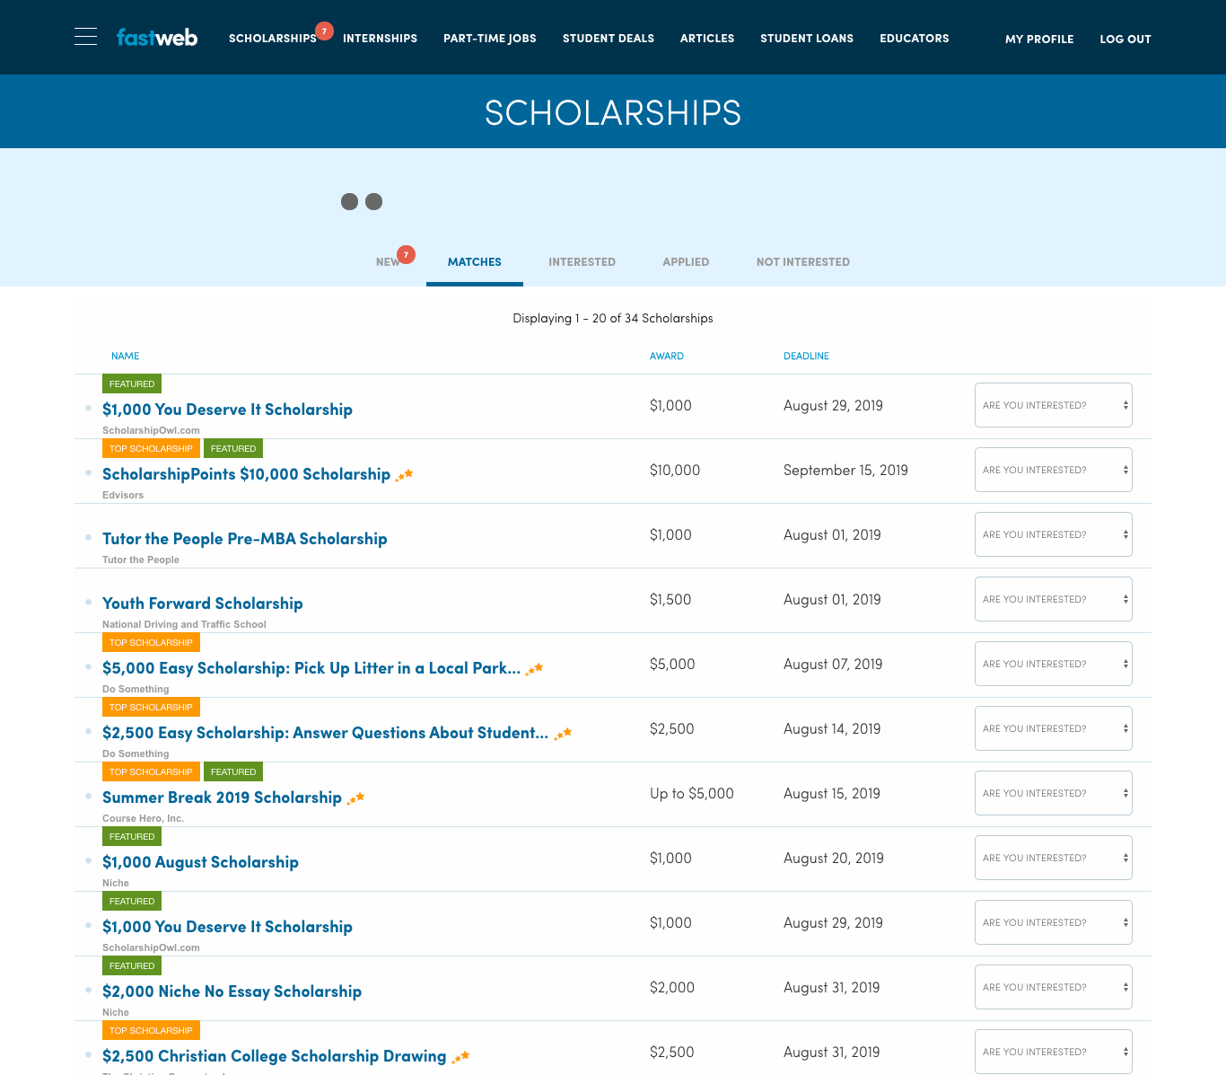
FASTWEB Results
Notes:
Here are some of the scholarships that matched.
You get the name and the value of each opportunity and a link to learn more. You’ll want to check back often because new opportunities are added regularly. Make searching and applying for scholarships an ongoing commitment throughout high school and college.

Slide 10
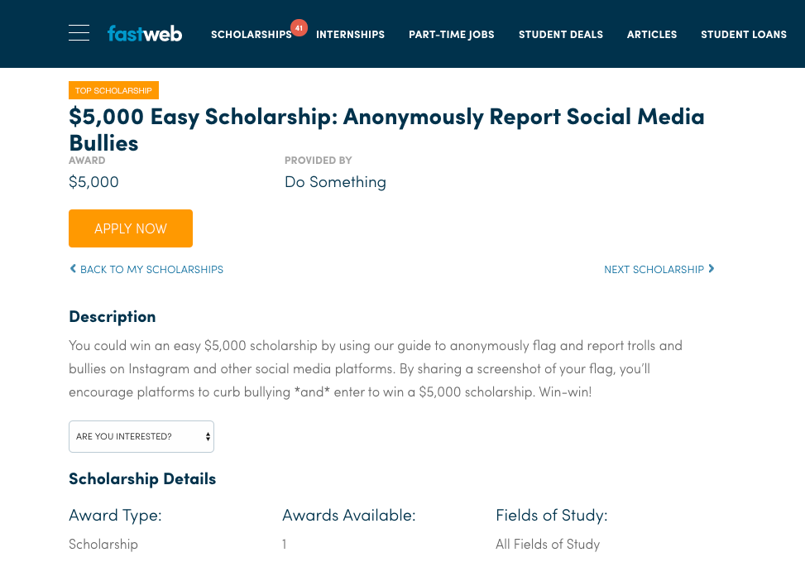
FASTWEB Scholarship Detail
Notes:
If we click on one we get more details.
This scholarship is for $5,000 to reporting bullying on social media.
From here we can click through to the site to apply.

Slide 11

Scholarship Website
Notes:
And here’s what that looks like.

Slide 12


UNIGO Scholarship Search
Notes:
In addition to fastweb.com, I also mentioned a couple of other sites. One of them is Unigo.
The sites basically work the same and let you create an account for FREE and get access to thousands of scholarship opportunities.
Some of them are pretty fun too.

Slide 13

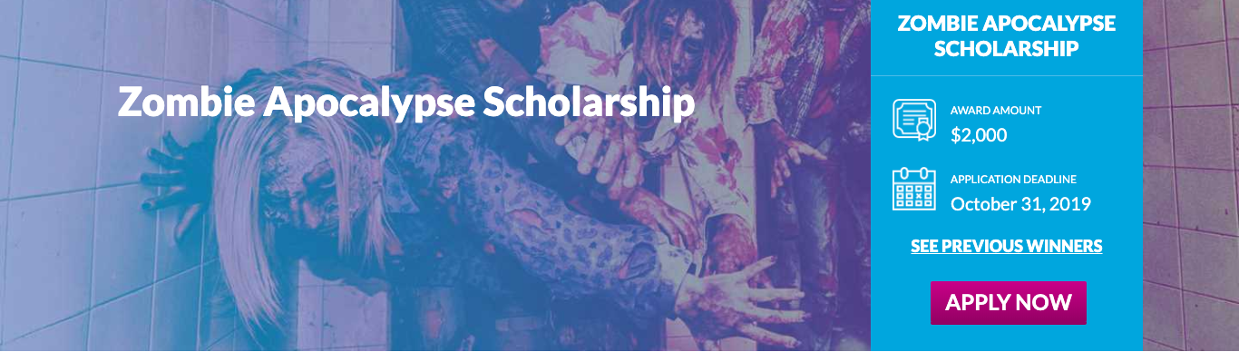
UNIGO Scholarship Listings
Notes:
Like these two:
To apply for the Flavor of the Month Scholarship you have to describe what flavor of ice cream you would be and why.
The Zombie Apocalypse scholarship requires you to write about your school being overrun with zombies and explain what you would do to survive.
[Additional information about these scholarships to share with students if time allows]
Submit an online short written response (250 words or less) for the question:
"Summer and ice cream go hand-in-hand. In fact, July is National Ice Cream Month, and that's the inspiration behind this award. We think people are very similar to ice cream; some are nutty, others a little exotic, while some are very comforting. If you were an ice cream flavor, which would you be and why?"
Submit an online short written response (250 words or less) for the question:
"Imagine that your high school/college has been overrun with zombies. Your math professor, the cafeteria ladies and even your best friend have all joined the walking dead. Flesh out a plan to avoid the zombies, including where you’d hide and the top 5 things you’d bring to stay alive."

Slide 14



Scholarship applications may require
Essay
Letters of Recommendation
Interview
High School Transcript
Notes:
Now that I’ve shown you where you can find scholarships and shown you some of the types that are out there, let’s see what you might need to complete the applications.
They may ask for an essay, letters of recommendation, your high school transcript, or require an interview.
Remember, every scholarship is different and so are the applications.
You might need some, all, or none of these things, but by being prepared and organized, you’ll maximize your chances of winning a scholarship.

Slide 15



Applications
TIPS
Watch deadlines
Follow all instructions
Submit all required documents
Have another person review
your application
Confirm your application
was received
Notes:
First let’s talk about overall application tips.
The number one thing you can do is to watch deadlines carefully. Late applications are usually denied.
You’ll also want to be sure to:
Follow all instructions--don’t give them a reason to toss your application out
Submit all required documents—don’t leave anything out
Have another person review your application—proofreading is important
And finally, confirm your application was received—send an email or make a phone call

Slide 16


Essays
TIPS
Type your essay
Ask someone to proofread
Add style and personality
Reuse essays by tailoring
them for each new application
Notes:
Here are some tips if writing an essay is required:
Follow directions. Often you’ll be instructed to write about a specific topic, so make sure you stay on topic.
First impressions are important, so be sure to type your essay.
Ask someone to proofread your essay—mistakes will make it look like you don’t care.
Add style and personality to your writing. Make your essay stand out and show them who you are—don’t be boring.
Reuse essays by tailoring them for each new application. Once you get one done you can often make small changes and use it again.
Sometimes they might leave the essay topic up to you. Use this as an opportunity to tell what makes you unique.
It helps you think about your:
Activities
Accomplishments
Future plans
Your character
Some ideas to write about in your essay include (read as many as you want):
Family background
Long-term & short-term goals
Commitment to service/ volunteerism
School & community activities
Awards & recognition
Work experience
Key accomplishments
Who you admire the most (a role model)
Who has inspired you
Life-changing event
Patriotism
Current events
Social justice issues

Slide 17



Letters of recommendation
TIPS
Consider asking your teacher, coach, counselor or pastor
Give letter writers enough time
Send a thank you note
to letter writers
Notes:
Some scholarships require you to provide a letter of recommendation. Here are some tips for getting them:
Consider asking a teacher, coach, counselor or pastor.
Give letter writers enough information about the scholarship and plenty of time to write their letters.
Letters should describe your skills, accomplishments and personality.
It’s best practice to:
Give the letter writer a deadline and confirm that works with their schedule.
Ideally give them a few weeks to write the letter.
If you want the letter writer to send the letter for you, make sure you provide a pre-addressed, stamped envelope. Or, they may be able to upload the letter—if that is the case make sure to give them the URL of the scholarship website.
Be sure to send a thank you note to your letter writers when they are finished.
Who better to tell people more about yourself than you?
Make sure to tell them:
What you are applying for
Why you picked the scholarship
Activities you’ve been involved in
Classes that you’ve taken
Awards that you’ve received
Key points you want them to include
Some of your letter writers may have lots of other letters to write. Providing this type of information will help them focus on you.

Slide 18

TIPS
High school transcripts
Ask your counselor what the process is for your high school
  Parchment
  Naviance
Notes:
If the scholarship requires your high school transcript, make sure you ask your counselor what the process is for your high school. They may use systems like Parchment or Naviance.

Slide 19


Common mistakes
Failing to follow directions
Applying for scholarships
you are not eligible for
Writing a boring essay
Not applying for scholarships
you are eligible for
Notes:
So I’ve gone over a lot of tips to help you be successful.
Now I want to go over some of the most common mistakes students make when applying for scholarships so you don’t make the same ones.
Students fail to follow directions (essay length, number of recommendations or fail to include the required information.)
Students also apply for scholarships that they are not eligible for. Make sure you know who is eligible to avoid wasting your time.
And many students fail to tailor the application to the sponsor or write a boring essay.
It’s also a mistake to fail to apply for an award for which you are eligible. The more you apply for the more you can win.

Slide 20




Beware of scholarship scams
Never pay money to get money
Nobody can guarantee that you’ll
win a scholarship
Do not give out personal information
  Bank account numbers
  Credit card numbers
  Social security numbers
Notes:
An important thing to watch out for is scholarship scams.
If you have to pay money to get money, it is probably a scam.
Never invest more than a postage stamp to get information about scholarships or to apply for a scholarship.
Nobody can guarantee that you’ll win a scholarship—so don’t believe it if someone promises you or guarantees you money.
Do not give out personal information like bank account numbers, credit card numbers or social security numbers.
It’s in your best interest to use free, reliable resources like the websites we looked at earlier.

Slide 21

Students studying STEM majors tend to win more scholarships
Notes:
Here’s an interesting fact:
Students studying a STEM major (science, technology, engineering or math) tend to get more scholarships compared to students in other majors.
This is primarily due to the fact that jobs in these fields are considered in-demand and there is lots of money being given to increase the number of students pursuing a degree in one of them.

Slide 22

WORTH YOUR TIME
Two $1,000 scholarships won
Total received $2,000
÷
5 hours spent applying
=
$400 per hour!
Notes:
Applying can be well worth your time.
Let’s say that it takes you 5 hours to complete 10 scholarship applications, and you win two of those, each worth $1,000. That’s $2,000 for just 5 hours of work, meaning you earned $400 an hour.
The more time you spend applying, the better your chances of winning and the more you earn to help pay for college.

Slide 23


TAKE ACTION Step 1
1
Get organized
  Make a list of the scholarships you
  are eligible for and their requirements
  Note the application due date
Notes:
So take action and get yourself some scholarship money.
Get yourself organized and keep track of the scholarships you are eligible for, the due dates and their requirements.

Slide 24
TAKE ACTION STEP
2
2
Pull together and request information
  Personal information
  List of activities
  List of jobs
  List of community/volunteer service
  Personal essay
  Letters of recommendation
  High school transcript
Notes:
Then you can start pulling together and requesting everything you might need, such as:
Personal Information
List of activities
List of jobs
List of community/volunteer service
Personal essay
Letters of recommendation
High school transcript

Slide 25
TAKE ACTION STEP 3
3
START APPLYING!
Notes:
Once you have everything you need you can complete your applications and start winning!

Slide 26

REVIEW
Make searching and applying for scholarships
an ongoing commitment
Carefully follow application instructions
and avoid missing deadlines
Beware of scams
To win more, you need to apply for more—
it’s worth your time
Notes:
We have talked about a lot today so let’s take a few minutes to review.
Make searching and applying for scholarships an ongoing commitment
Take advantage of the free websites I shared with you today to find scholarships that are right for you. And remember that new opportunities are added regularly.
Carefully follow application instructions and avoid missing deadlines
Pay attention to details and don’t let deadlines sneak up on you.
Beware of scams
Searching and applying for scholarships shouldn’t cost you anything, and never give out credit card or social security numbers.
To win more, you need to apply for more—it’s worth your time
Applying is a numbers game and winning scholarships can earn you more than a part-time job.

Slide 27



Thank You For Attending
© 2019 Ascendium Education Group, Inc. All Rights Reserved.

