Slide 1

Completing the FAFSA
Completing
the
FAFSA®
{How to unlock money for college}
2020-21 Academic Year
Notes:
[Note to Presenter: This presentation can be used with parents and/or students, but the speaker notes are written with a parent audience in mind.]
First, I want to thank you for coming. You all show me that you want to help your kids get to college, and by being here, you’ve taken an important first step in helping them get there.
It’s no secret college can be expensive.
The good news is there is money available to help pay for college. In fact, there are billions of dollars out there, and some if it is even free money that doesn’t have to be paid back. Everybody likes free money, right?
And the FAFSA is the key to unlocking it. After today you shouldn’t have any questions about how to pay for college or hesitations about pursuing the dream of going.
Today we’re going to talk about the different types of aid available.
I’ll also help you understand how to complete the FAFSA and answer any questions you may have so you can easily complete this important form and put your student on the path to college. So, let’s get into it and find out how you can get some free money to help pay for college.
Can anyone tell me what FAFSA stands for [allow parents to answer]?
Can anyone tell me why it’s so important to complete the FAFSA [allow parents to answer]?

Slide 2

Completing the
FAFSA® is the key!
The Free Application for Federal Student Aid (FAFSA)
helps families access:
    Federal funds
      Grants, work-study, student and parent loans
    State funds
      Grants, scholarships
The federal government
is the number one source of money
to help students pay for college.
Notes:
As I said, the FAFSA is the key! That’s why we are all here today. When you and your student complete the Free Application for Federal Student Aid, you are applying for federal financial aid from the government—the #1 source for college financial aid.
Maybe you’ve heard about what a bear the FAFSA is to fill out, and it’s partially true. Let’s face it, it’s a government form, so why do in 10 questions what you can do in a hundred, right?
But actually it’s not as bad as you might think, and after today, you’ll have a better understanding of what it is and what you need to do.
Recently there have been a few major upgrades that will make it even easier, too. The fafsa.gov website has been redesigned so that the site pages will fit the screen size and shape of any computer or device, including mobile devices such as smartphones or tablets. And, the online FAFSA form provides faster feedback. For example, you’ll be notified of any errors immediately upon completing the form's fields.
Completing the FAFSA is the first and most important step you and your student need to take to get financial aid.
It’s how you get access to federal grants, work-study and government loans as well as state grants and some scholarships.
Now let’s talk about grants, work study and loans and how they can help get your student to college.

Slide 3
Federal Grants
Pell Grant up to
$6,345
Supplemental Education Opportunity Grant (SEOG) up to
$4,000
Notes:
Federal grants are money for college that does not have to be repaid. The first, and largest, type of federal grant available to those who qualify is called the Pell grant. For the 2020-21 academic year, students can receive up to $6,345 a year towards college. Pell grants are based upon financial information reported on the FAFSA, and they are provided to every student who qualifies.
Another type of grant is the Supplemental Educational Opportunity Grant. This grant can range from $100 to $4,000 a year, and like the Pell grant, it is based on your family’s income. The difference between the Pell grant and SEOG is that there are unlimited funds for the Pell grant so anyone who is eligible will get it. Funds for the SEOG grant run out and when they are gone, they are gone—which is a good reason to complete the FAFSA as soon as possible.
Your student can apply for grants regardless of the type of college they are going to; technical/community, 2-year or 4-year colleges. Grants are based on financial need, and not the type of undergraduate degree they will pursue, such as an Associate vs. a Bachelor’s degree.

Slide 4

Federal Work-Study
Flexible hours
Mostly on campus
Paid for hours worked
Notes:
Work-study is money earned by working a job on or near campus. Colleges know of your student’s interest in work-study if they check “yes” in the work-study box on the FAFSA. They should always check this box whether they think they will work or not! If they are offered work-study, they don’t have to accept it, but it is a great way to earn more money to pay for personal and college expenses.
On-campus jobs are convenient because your student can often work between classes. These jobs can also be a way to meet and connect with new people.
[Insert personal story if you had work-study and the connections that you made.]
Just like any job, your student will get paid for the hours they work. They will receive a paycheck (sometimes every two weeks, sometimes monthly) and they can use it for textbooks or food or save it for paying tuition – it’s their choice what college expenses they use it for.
Each college treats work-study differently. If your student qualifies, they may be assigned a job or they may have to apply for a job so they’ll need to pay attention to what’s required of them. There isn’t a guarantee that they will get a job, but if they take all the steps needed, they’ll definitely have a good chance.

Slide 5

Federal Student Loans
Direct Loans | Maximum amount FRESHMAN YEAR | Interest FREE WHILE IN COLLEGE? | Interest rate 7/1/20-6/30/21 | Fees 10/1/20-10/1/21 | Repayment
Subsidized | $3,500 | Yes | 2.75% | 1.057% | Six months after graduation OR if enrollment drops below ½ time
Unsubsidized* | $2,000 | No | 2.75% | 1.057%
*If student doesn’t qualify for a Subsidized loan, colleges may offer
up to an additional $3,500 in Unsubsidized ($5,500 in total).
Notes:
By completing the FAFSA your student may qualify for Federal Student Loans.
The two types of Federal Student Loans, also known as Direct Loans--subsidized and unsubsidized. The big difference between these two loans is that subsidized loans are based on financial need and unsubsidized are not.
Your student can borrow a total of $5,500 as a first-time freshman between both loan types.
If your student doesn’t qualify for a subsidized loan, colleges may offer up to an additional $3,500 in unsubsidized loans, for a maximum of $5,500.
There is no credit check and they do not need to start paying the loan back until six months after they graduate or drop to less than half-time enrollment (6 credits). The interest rate on both subsidized and unsubsidized loans can change from year to year, but once a student takes out a loan, the rate is fixed for the duration of the loan. For loans made between 7/1/20 and 6/30/21, the interest rate is 2.75%. Rates are determined in July just before the academic year.
For the subsidized loan, the government covers the interest making it an interest free loan during enrollment. For an unsubsidized loan, the student is responsible for the interest and it accrues while the student is in college.
A little tip: If your student accepts an unsubsidized loan, which is the loan that they are responsible to cover the interest for, they can save a lot of money if they make interest payments while they are in college. If they don’t pay the accruing interest, it will be added to the principal amount of the loan and increase the amount they have to repay.
Family financial need as calculated by the FAFSA will determine whether your student gets both a subsidized loan and an unsubsidized loan or just an unsubsidized loan.
Student Loan Fees: Most federal student loans have loan fees that are a percentage of the total loan amount. Your student does NOT need to come up with any money to pay this fee. The loan fee is deducted from each loan disbursement your student receives. This means the money they receive will be less than the amount they actually borrow. Your student is responsible for repaying the entire amount they borrow and not just the amount they received.
So, let’s say your student is offered a subsidized loan for $2,500 which is the amount they will be responsible for paying back. Once the loan fee of 1.057% or $26.42 is deducted, your student will receive just over $2,473.58 to use towards their college costs. (Source: https://studentaid.ed.gov/sa/types/loans/interest-rates)

Slide 6
Federal Parent Loan
Direct PLUS LOAN | Maximum amount each YEAR | Interest FREE WHILE IN COLLEGE? | Credit check required? | Interest rate 7/1/20-6/30/21 | Fees 10/1/20-10/1/21 | Repayment
Parent PLUS | Up to cost of attendance minus all other aid | No | Yes | 5.30% | 4.228% | Can pay as you go OR once student drops below ½ time, leaves school or graduates
Notes:
For all of the loan types we’ve talked about so far, the student would be the borrower. In the Federal PLUS loan program, you, the parent, would be the borrower, and would be the one required to pay back this loan.
To receive a Direct PLUS loan, you must meet certain credit requirements. Once approved, you may borrow up to the cost of attendance minus any other financial aid received.
For loans made between 7/1/20 and 6/30/21, the interest rate for a Direct PLUS loan is 5.30%. Like the subsidized and unsubsidized, this rate is fixed for the life of the loan.
Repayment begins immediately after the last disbursement of the loan, but parents can choose to delay those payments until six months after the student graduates or drops to less than half-time enrollment. If you choose this payment option, be aware that interest still accrues!
These loans also have loan fees that are a percentage of the total loan amount. You do NOT need to come up with any money to pay this fee. The loan fee is deducted from each loan disbursement just like federal loans. The Parent PLUS fee for loans made between 10/1/20 and 10/1/21 is 4.228%.
(Source: https://studentaid.ed.gov/sa/types/loans/interest-rates)

Slide 7
State Grants & scholarships
FAFSA may be required
  Must meet college’s priority date
  located on financial aid website
Grants may be based
on financial need
Funding will run out
Notes:
Some states, like Wisconsin, offer state grants to students who attend colleges in their state. Your student may be required to complete the FAFSA to be eligible for the state grants that are available (the FAFSA is usually the application and most of these are automatically awarded). In Wisconsin the FAFSA is required for state grants. There are a few state grants that have additional requirements, for example is the grant for students with disabilities.
Much like federal grants, state grants are given based upon financial information reported on the FAFSA. However, they are awarded on a first come, first served basis and funding will run out. So you should complete the FAFSA as soon as possible and make sure to meet the college’s priority date.

Slide 8

Other Types of Student Aid
Notes:
Let’s move on and talk about some other types of financial aid.

Slide 9

Scholarships
Money gifted to students that can be based on:
Academic merit
Special skills and talents
Membership and/or service to an organization
Financial need
Luck
Other
FAFSA may be required to apply
Notes:
Scholarships are not a type of federal financial aid and the funds do not have to be repaid. Each scholarship has its own application and they are available to all kinds of students! Scholarships are awarded for many things besides GPA. There are scholarships out there for students who draw well (Doodle for Google) and there is even a “Zombie Apocalypse” scholarship for which all the student has to do to apply is submit an short online written response (250 words) to a question about their high school being overrun by Zombies!
Not to confuse matters but sometimes a scholarship application may require that the student complete the FAFSA so they can decide how much money may be awarded to them based upon their family’s income. So part of the selection process may be based on financial need as calculated by the FAFSA. Not all scholarships work this way—I just want you to be aware and to pay attention to the details of each scholarship application.
As a final reminder, your student has to complete separate scholarship applications to be eligible!
So where can you and your student find scholarships? Let’s talk about that.

Slide 10
Scholarships
Where to look and who to ask:
School counselor
Church
Community foundations
Employer
Businesses and service organizations
College websites
and financial aid offices
Online:
  Fastweb.com
  Niche.com
  Scholarships.com
  Petersons.com
  Unigo.com
  CollegeGreenlight.com
Notes:
There are many different places to find scholarships and many of them are listed here [go through sources and give examples as appropriate]. One of the easiest ways to find scholarships is doing an online search through websites like fastweb.com. and scholarships.com.
Simply Google “scholarships.” You’ll get many different sites to look at. Just like with the FAFSA, your student should not pay for the application, so avoid any site that asks for a credit card. You can also search for scholarships aimed at students with characteristics like your student’s. For example, if they do a lot of volunteer work, search for “scholarships for community service,” “scholarships for social justice,” “scholarships for volunteering,” etc. You will be surprised at what is out there.
Also, you should check with local businesses, because many of them offer scholarships as well [give examples of any local businesses you know who award scholarships].
The local or school library often has large resource books that will show detailed contact information and scholarship requirements. Ask the librarian.
Your church or faith-based organization may have scholarships specific to the congregation. Ask your church leaders.
Your employer may offer scholarships for the children of employees; you simply have to ask! Human Resources is the department where you could start.
Have your student ask the college financial aid office if there are separate applications for scholarships and where they can find them. Again, they should use the campus resources to their advantage.

Slide 11
Private Bank Loans
Money borrowed by student or parent:
Explore all other options first
Credit check required
Terms vary by lender
  Interest rates and loan limits
  Limited repayment plans
  May require co-signers
Notes:
Non-federal loans, most commonly known as private loans, should really be the last option to pay for college. These are loans that are from private lenders like banks and credit unions. They are advertised a lot! These are different than the federal student loans that we discussed earlier.
What makes them different?
-They are not part of the FAFSA and will not be on the college’s aid package, although some colleges may require completing the FAFSA so they can review you for federal aid.
-They require a separate application through the bank.
-Typically these private loans aren’t as flexible as federal student loans and won’t have many options if your student has difficulty making payments.
-Private loan interest rates are set after your student applies and are based on each individual, so they won’t know what the rates are until then. Interest rates can be, and often are, higher than the federal loans we discussed earlier.
-Often they require a co-signer like a parent, family member or friend, who is just as liable for repayment as your student.
I only mention these loans so that you are aware of their existence because they are heavily advertised and you and your student should make them a last option to pay for college.

Slide 12


Completing the FAFSA
Notes:
Now we’re going to walk through how to complete the FAFSA one step at a time.
At times financial aid and the FAFSA may seem confusing, because after all, it is the Federal Government you’ll be working with! It’s kind of like doing your taxes. But we will get through it. So don’t be afraid--I’m here to help and there is additional help available when you and your student start working on your FAFSA.
The FAFSA can help you pay for all kinds of schooling beyond high school: technical/community colleges as well as 2-year and 4-year colleges.
[if applicable]
I’ll be available after this presentation to provide one-on-one assistance with completing the FAFSA or with any financial aid questions, so please feel free to stay and complete your FAFSA today!
I’ll also be available at your student’s school on [day/time] in case you need additional assistance or can’t stay today/tonight.

Slide 13
Use your 2019 taxes!
Can start October 1 of your student’s
senior year in high school
Can use 2019 federal income taxes
for 2021-22 FAFSA
Notes:
Recent changes mean good news for you:
Your student can file starting October 1 of their senior year.
Because they can file earlier, you can use last year’s federal tax information.
In the past, filing began on January 1, and would require you to provide tax information from the year that just ended.
Now, they can file the FAFSA beginning on October 1, and use the tax information filed last year. The government calls this “prior-prior year,” but for you and me that means when you complete the FAFSA for the 2021-2022 academic year, you can use the information on your 2019 federal income tax return.
Another point I want to make is that for most people, it should only take 30 minutes to an hour to complete the FAFSA, so it’s not as bad as you may have thought.
Now, let’s get started!

Slide 14
Create an FSA ID
Acts as an electronic signature
Requires Social Security number
Consists of username and password
  Student and parents
  each need their own FSA ID
Notes:
To begin, you and your student will both need to create an Federal Student Aid (FSA) ID. FSA is part of the U.S Department of Education—the part of the federal government that administers the FAFSA.
An FSA ID is a username and password that acts as your electronic signatures.
This is necessary to submit and sign the FAFSA online.
If you have a child who completed the FAFSA prior to 2015, an FSA ID wasn’t needed.
I want to note that you must have a Social Security number to create an FSA ID.
Once you have your FSA ID, don’t forget it! You don’t want to write down your username and password where someone can see it and gain access to your information. A good idea is to write down a hint to help remember it.
[Can also mention note about no SSN:]
If you don’t have a SSN, you can’t create an FSA ID, but you can still sign your student’s FAFSA. It will require your student to print out the signature page so you can sign it and mail it in. I’ll talk more about that later.
Please note your student must have a SSN or an alien registration number to complete the FAFSA.

Slide 15
Go to: fsaid.ed.gov
For help with a question, click on the gray question marks
Select “Show Text” to see what you’re typing
Have all of your information ready to avoid
the session timing out
Notes:
Remember these tips when you get to fsaid.ed.gov:
For help with a question, click on the gray question mark next to it.
Select “Show Text” to see what you’re typing.
Have all of your information ready; if you take too long to enter it, your session will time out and you will have to start over.

Slide 16
To complete the FAFSA students and parents need:
Social Security number
(and alien registration number)
Dates: birth, death, marriage, and divorce
2019 W-2s and tax returns
Most recent bank balances
Amounts of any
other income
Net value of assets
Notes:
Once you and your student have your FSA IDs, you will both also need to have these six things to complete the FAFSA.
1 – Your Social Security number. If you don’t have a Social Security number, that’s okay for the FAFSA, but your student will need their SSN and alien registration number if they have one.
[if mentioned earlier you can add]—As I mentioned, if you don’t have a SSN you won’t have an FSA ID, which means your student will need to print out the signature page so you can sign it and mail it in. We’ll go over that in more detail later.
2 – Birthdays, marriage date (parents/legal guardians) and date of divorce (parents/legal guardians). If your spouse passed away, you will need that date as well.
3 – For the 2021-2022 academic year FAFSA, you’ll need your 2019 W-2 forms and tax returns.
4 – Bring the current balances of any bank accounts you or your students have, like checking or savings accounts
5- You will need to know the amount of any other income, like child support [provide more examples as appropriate to your audience]
6 – You will also need to know the value of any assets you or your student has, like a rental or vacation property you own, or stocks, bonds and mutual funds [provide more examples as appropriate to your audience]. You will not need to include the value of the house you live in—I’ll provide more detail on this shortly
Remember “6 to submit, “ because if you bring what you need the first time, you will get your FAFSA in earlier and that gives you a better chance of getting more financial aid - like grants!

Slide 17


When can you complete the FAFSA?
As soon as possible after October 1 of the student’s senior year
Before each college’s priority date – located on financial aid webpage
When can you complete the FAFSA?
Notes:
Now let’s talk about when you and your student can complete the FAFSA.
Earlier I mentioned that the FAFSA is available October 1. Your student should aim to complete the FAFSA as soon after that date as possible.
I also talked about college priority dates. It’s important that they get their FAFSA completed before each college’s priority date in order to get as much aid as they are eligible for. You can find a college’s priority date on their website in the financial aid section. There is a limited amount of some types of financial aid, so you want to make sure your student gets their FAFSA done before that priority date. In other words, the sooner the better.

Slide 18

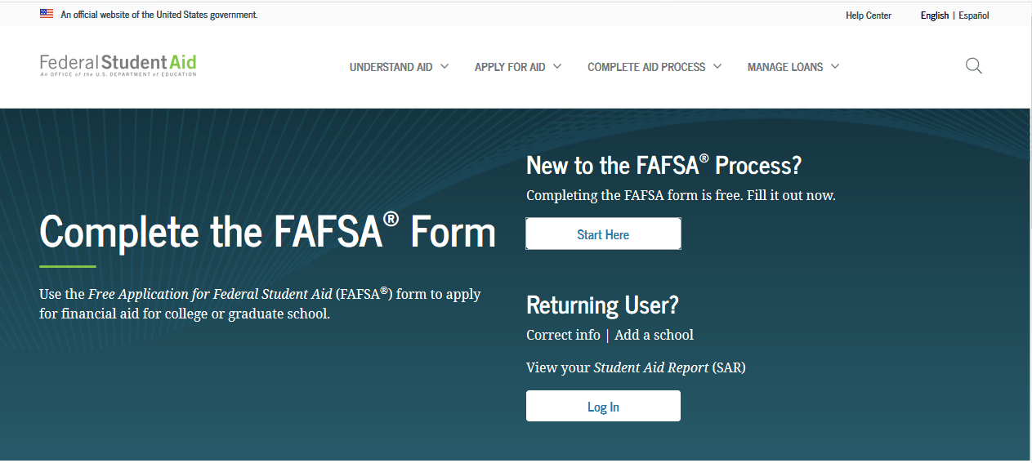
FAFSA.gov
Notes:
This is a screen shot of the official FAFSA.gov website. Avoid all other FAFSA websites or apps—many may try to charge you a fee to complete the FAFSA. So only go to FAFSA.gov and remember it’s always free to complete the FAFSA!
I am available to help you complete your FAFSA free of charge and [insert what you can provide here – I’m coming back to your school to help with FAFSA completion, I can schedule a day/time to come back to your school to help with completion].
It is easiest and fastest to complete your FAFSA online, but you can download a paper copy through the FAFSA.gov website. If you do complete the paper FAFSA, it will take longer to process than if you complete it online.

Slide 19
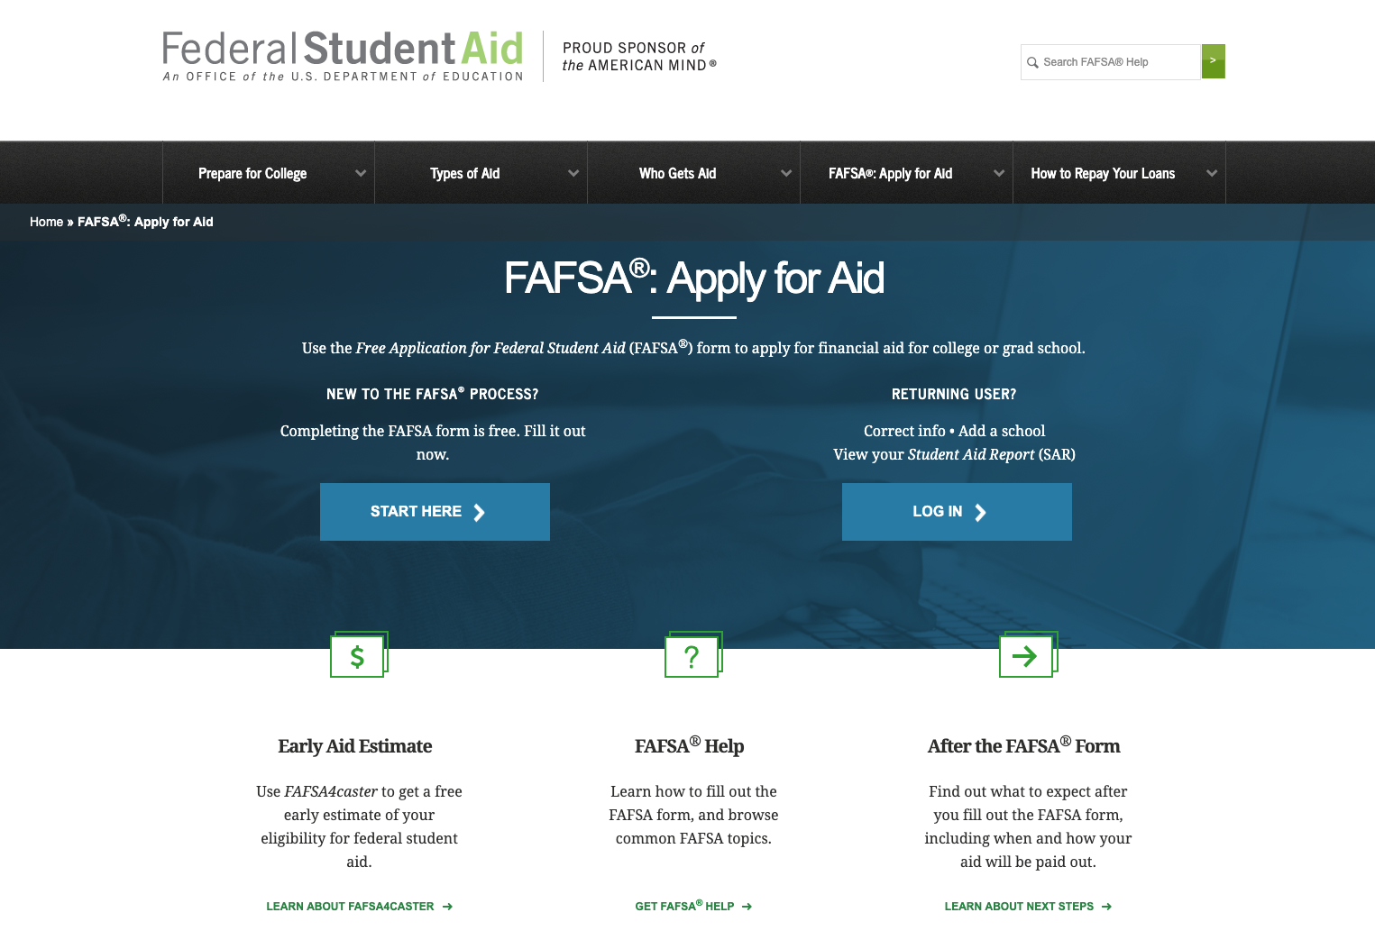
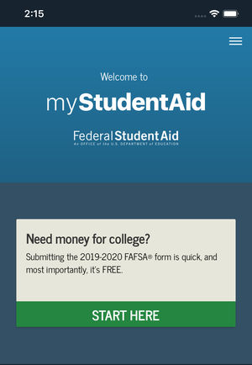

My Student Aid Phone app
Notes:
Students and parents can also complete the 2021-22 FAFSA through the myStudentAid mobile app, which is available for download in the Apple Store (iOS) or Google Play (Android).

Slide 20
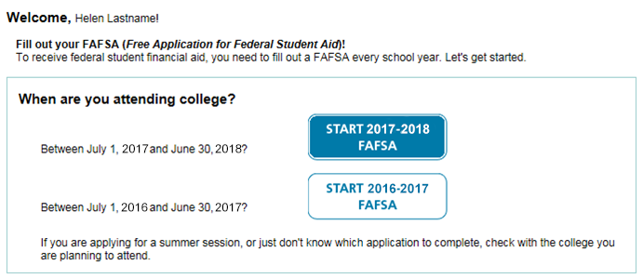
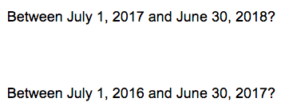
Select “Start 2021-2022 FAFSA” for 2021 high school graduates
2021-2022
Between July 1, 2021 and June 30, 2022
2020-2021
Between July 1, 2020 and June 30, 2021
Notes:
When your senior gets started, it’s important they select Start 2021-2022 FAFSA.
Now we’ll take a look at the different sections of the FAFSA.

Slide 21
Section 1:
Student Information
Provide:
Social Security number
Address
Email
Use “Help and Hints” section if you get stuck
Say “yes” to work-study
Notes:
Section 1 is the student information section. This is where name, Social Security number, address and email get entered.
One important note for your student—they should not use their high school email address. They should use an email that they check frequently and will use for years to come—eventually their high school email address will expire and that will be a problem.
I also want to point out that throughout the FAFSA at the right of each screen is the “Help and Hints” section. You’ll see information on what section you are in and tips to help complete the FAFSA accurately and easily. If your student isn’t clear on what the question is asking, they should look at this box. This will be especially helpful when completing the income and assets questions.
Another question you’ll see in this section asks if you’re interested in being considered for work-study. As I mentioned earlier, work-study is money earned by working a job on or near campus. It’s always good to select “yes.” If students are offered work-study, they don’t have to accept it, but it is a great way to earn more money to pay for personal and college expenses.

Slide 22
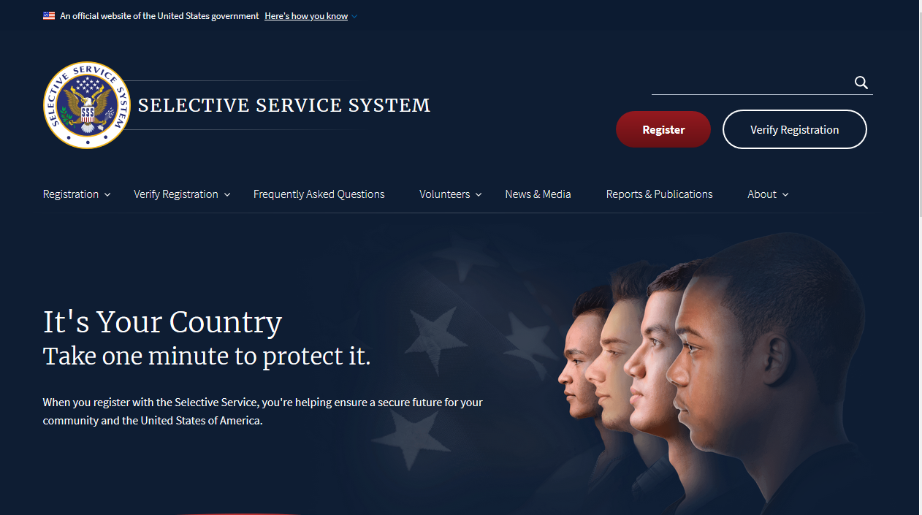
Section 1:
Student Information
Register online at sss.gov
Notes:
One question worth noting for male students is: Are you registered with the Selective Services System?
If your student is a male and between 18 and 26 years old, they will need to register with the Selective Service in order to receive federal financial aid. If they haven’t done so already and are less than nine months away from their 18th birthday, they can register while completing the FAFSA.
They can also register at www.sss.gov or at the post office.

Slide 23
Section 1:
Student Information
High School lnformation:
Enter high school name, city and state
Select high school in the list of options
Click confirm
Notes:
Another part of the Student Information section covers the high school your student attends. They will need to type in the name, city and state of the high school and then click “confirm.” A list of high schools that match what they typed in will pop up. They will need to select their high school and click “confirm” again. If they have trouble finding the high school, they should try typing in fewer words. [Use example for school that you’re at.] Make sure they hit “confirm” before moving on to the next step!

Slide 24
Section 2:
Student Financial Information
Enter 2019 Federal Income Tax Information
  Manually
  IRS Data Retrieval
Notes:
Next is section 2, which requires entering financial information for the student. Parents enter their tax information later in section four.
When we started today, one of the pieces of good news I shared is that you and your student will be able to use 2019 tax information.
This means you’ll be using tax information for taxes you’ve already completed. You’ll have the option to enter your information manually or use the IRS Data Retrieval Tool.

Slide 25
Section 2:
Student Financial Information
IRS Data Retrieval
  Save time
  Avoid errors
  Satisfies most colleges’ verification requirements
Notes:
The IRS Data Retrieval Tool allows you to prefill the answers to some financial questions on the FAFSA by transferring data from your federal income tax returns.
This can save time and it will also help avoid errors that can occur when entering information manually.
Another good reason to use the IRS Data Retrieval tool is that it will also save time later as it satisfies most colleges’ verification process—which is a step that occurs after submitting the FAFSA.

Slide 26
Section 2:
Student Financial Information
Bank balance and asset information
Report these assets and investments:
  Investment property
  Trust funds
  CDs (Certificates of Deposits)
  Stocks and bonds
  UGMAs and UTMAs that you own
  529 education savings plans
  Current business or investment farm
Notes:
After tax information has been entered, bank balances and asset information need to be entered.
Assets and investments to report include, but are not limited to:
Real estate investments
Rental property investments
Trust funds
Money market funds, mutual funds, certificates of deposits (CDs)
Stocks, stock options, bonds
Uniform Gift to Minors Act (UGMA) & Uniform Transfer to Minors Act (UTMA) accounts
Education savings plans (e.g., Coverdell, 529 savings, 529 prepaid)
Current business and/or investment farm

Slide 27
Section 2:
Student Financial Information
Do NOT report these assets or investments:
  The home you live in
  A farm you live on and materially operate
  Life insurance
  Retirement accounts (e.g., 401(k), pensions, Keogh, IRAs)
  The value of a small business if your family
  owns and controls more than 50% of the business
  and the business has fewer than 100 full-time
  or full-time equivalent employees.
Notes:
It’s important to know what information is not needed.
Do NOT report these assets or investments:
The home you live in
A farm you live on and materially operate
Life insurance
Retirement accounts (e.g., 401(k), pensions, Keogh, IRAs)
The value of a small business if your family owns and controls more than 50% of the business and the business has fewer than 100 full-time or full-time equivalent employees.

Slide 28
Section 3:
Student Status
Parent information is not required if the student checks at least one of these:
Born before January 1, 1997 | Have children and provide more than half of their support
Both parents deceased since age 13 | Married
Dependent or ward of the court since age 13 | Have dependents (other than your children or spouse) who live with you and you provide more than half of their support
In foster care since age 13 | Unaccompanied homeless youth
Currently in legal guardianship | Veteran or on active duty
Enrolled in graduate or professional school
Notes:
The next section of the FAFSA deals with your student’s dependency status.
Parent information is not required if the student checks at least one of these:
Born before January 1, 1997
Both parents deceased since age 13
Dependent or ward of the court since age 13
In foster care since age 13
Currently in legal guardianship
Enrolled in graduate or professional school
Have children and provide more than half of their support
Married
Have dependents (other than your children or spouse) who live with you and you provide more than half of their support
Unaccompanied homeless youth
Veteran or on active duty
(Source: https://studentaid.ed.gov/sa/fafsa/filling-out/dependency)

Slide 29


Section 4:
Parent Information
Who provides parent information on the FAFSA?
Both biological or adoptive parents if they are:
  Living together, regardless
  of marital status or gender
Notes:
Section 4 is the parent information section.
One of the biggest questions that comes up about the FAFSA is which parent needs to provide financial information.
So let’s start first with the situations when both parents need to provide information. If the biological or adoptive parents are married or live together, both parents provide financial information.

Slide 30


Section 4:
Parent Information
If parents are divorced, separated or do not live together
Provide information for the parent the student lived with the most during the last 12 months.*
*If that parent
is remarried,
student must also include stepparent information.
OR
If the student lived with each parent equally, the parent who provided the most financial support provides their information.*
Notes:
In the case of divorce, separation, or single parents who do not live together, the parent the student lived with the most during the last 12 months would provide financial information. If the student lived with each parent equally, then the parent who provided the most financial support provides their financial information.
If the parent that is providing financial information is remarried, the student will also have to provide that stepparent’s information on the FAFSA.

Slide 31
Section 4:
Parent Information
Provide:
Marital status
Dates of birth
Social Security numbers
  If parent doesn’t have SSN,
  use all zeros (000-00-0000)
Notes:
The parent will provide information about marital status, dates of birth, etc.
One thing to note is, if you (the parent) don’t have a Social Security number, you can still enter your information and use all zeros for the SSN (000-00-0000)

Slide 32
Section 4:
Parent Information
Financial information repeats for the parent
  Federal tax information
      Manually
      IRS Data Retrieval
  Bank balance and asset information
Notes:
Just like the student had to, the parent will also need to enter their tax and asset information.

Slide 33
Section 5:
Student Household Information
Provide:
Household size
Federal benefits received:
  Supplemental Security Income
  Supplemental Nutrition Assistance Program
  Free or Reduced Price Lunch
  Temporary Assistance for Needy Families
  Special Supplemental Nutrition Program for Women, Infants, and Children
Dislocated worker status
Notes:
Section 5 contains questions about who lives in the student’s household and if anyone received federal benefits, including Medicaid or Supplemental Security Income (SSI), Supplemental Nutrition Assistance Program (SNAP), Free or Reduced Price Lunch, Temporary Assistance for Needy Families (TANF), or Special Supplemental Nutrition Program for Women, Infants, and Children (WIC)
This section also determines if the student is a dislocated worker which may automatically qualify them for specific federal aid, such as the Pell Grant.

Slide 34
Section 6:
List Schools, Sign and Submit
List up to 10 colleges the student might attend
Student can add additional colleges after the
FAFSA is submitted
Notes:
In section 6, your student will choose the colleges they want to send the FAFSA information to.
They can list up to ten colleges, so they need to make sure to enter all the colleges they are considering attending. If they’re not sure of all the colleges they want to apply to yet, or decide to add some later, they can go back to FAFSA.gov and add additional colleges after submitting the FAFSA (this can be done by clicking on “add a school” on the FAFSA homepage).
It’s also very important to remember that the FAFSA is not the college admission application! Students cannot apply for college at FAFSA.gov. They will need to complete college admissions applications through each college’s website.
They can either enter the state, city and name of the college(s) or if they know the college’s federal school code, enter it in the federal school code box. Once they have entered the college information, click search. Once they see the college they want to send the FAFSA to, click on it.

Slide 35
Section 6:
List Schools, Sign and Submit
Choose a housing plan:
  On campus
  Off campus
  With parent
Notes:
For each school or college selected, your student will also need to choose a housing plan. This is where they select whether they will be living on campus, off campus or with a parent. This information is important because the college financial aid office will use it when determining the cost of college.

Slide 36
Section 6:
List Schools, Sign and Submit
Chance to verify all the information
  Enter FSA ID to electronically sign
  If your student is a dependent, you and your student must both sign before submitting
Notes:
Section 6 also gives you the chance to verify all the information, enter an FSA ID to sign electronically, and submit the FAFSA.
If your student is a dependent then you (the parent) must also sign the FAFSA with an FSA ID before submitting.

Slide 37
Section 6:
List Schools, Sign and Submit
Another Signature Option
If you (parent) don’t have a Social Security number, your student must print a signature page
  In order to print it, you’ll need to turn
  off pop-up blockers
Notes:
If you (the parent) don’t have a SSN, your student must print a signature page.
In order to print it you’ll need to turn off pop-up blockers.

Slide 38
Section 6:
List Schools, Sign and Submit
If signing manually
  Both Student and Parent must sign before
  mailing to Federal Student Aid
Mail immediately
It will take longer to process the FAFSA
Notes:
Then you both need to sign it before your student can mail it to Federal Student Aid
Mail immediately
FAFSA will not process until this is received

Slide 39
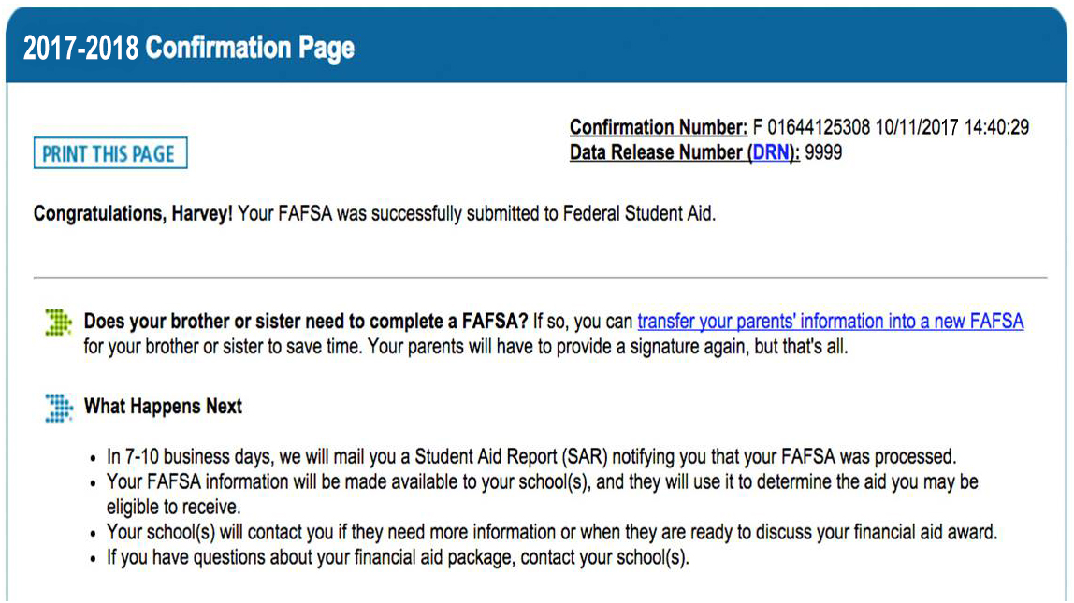
Section 7:
Confirmation Page
2021-2022
2021
Received once your FAFSA is successfully submitted
Notes:
After you’ve completed everything your student will see the confirmation page. When they see the confirmation page, they will know that they’ve successfully submitted the FAFSA. Congratulations! They can print this page, and it will also be e-mailed to them, so they should watch for that.
** If any other children in your family need to complete a FAFSA, the confirmation page will include a link that transfers all of the parent information into a new FAFSA. This option is only available on the confirmation page so look for this link if you need to complete more than one FAFSA in your family**
This is what the top half of the confirmation page looks like, here is the second half.
[click to next slide]

Slide 40
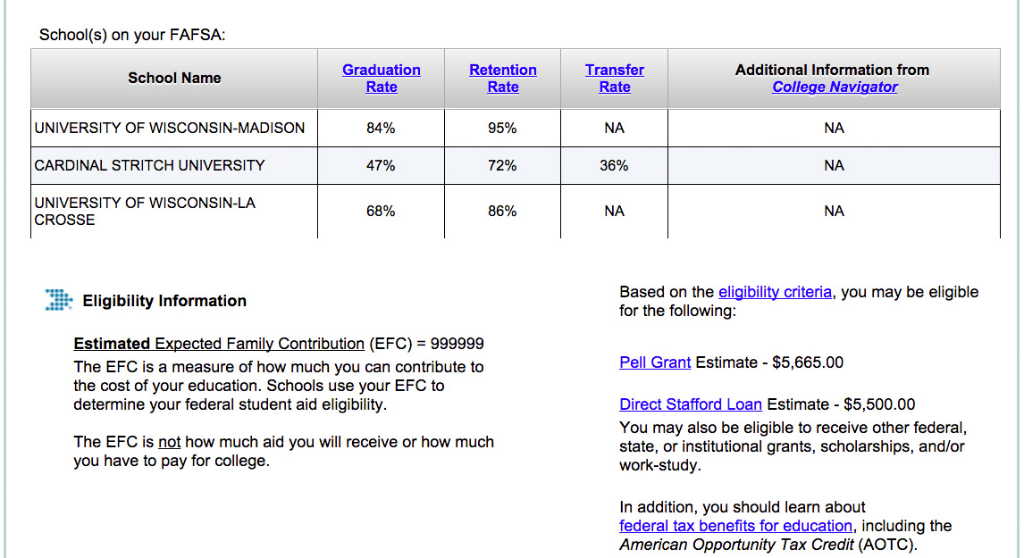
Section 7:
Confirmation Page
Sample College 1
Sample College 2
Sample College 3
00000
$6,195
Notes:
This will include information on the colleges you selected to have the FAFSA sent to, the estimated EFC or expected family contribution (this is based on a formula the government uses to determine what you and your student can contribute to college costs—it doesn’t mean you or your student need to pay this), and estimated federal grant and federal student loan amounts. These numbers are not final and can change based upon verification of tax and financial information provided by you and your student on the FAFSA.
Ok, now that we have covered the sections needed to complete the FAFSA, I am going to talk about what happens next.

Slide 41
What happens next?
Notes:
Now let’s look at what happens after the FAFSA.

Slide 42
Check for emails from Federal Student Aid
Typically arrives 3 to 5 days after submitting
the FAFSA electronically
Log in to FAFSA.gov using FSA ID
Download Student Aid Report (SAR)
  SAR is an itemization of information
  provided on the FAFSA
  Check SAR carefully for incorrect
  and/or missing information
Make corrections to FAFSA (if needed)
Notes:
Your student will need to watch for emails from FSA. The first one typically arrives 3 to 5 days after submitting the FAFSA electronically. The email will come from FederalStudentAidFAFSA@cpsemail.ed.gov with a link to FAFSA.gov.
Log in to FAFSA.gov using an FSA ID. Download the Student Aid Report—it contains all the information provided on the FAFSA. Check the SAR carefully for incorrect and/or missing information.
Make necessary corrections and/or provide missing information if needed
If the financial aid office doesn’t have all of the information it needs, your student might:
Not receive all of the aid they are eligible for
Not receive any aid
Have to return aid that they received in error
Call 1-800-4-FED-AID if your student does not have a SAR within two weeks of filing their FAFSA.

Slide 43
Check College Student Portals
Complete FAFSA verification (if selected)
Review financial aid offers
Accept financial aid
Receive financial aid
Notes:
Your student will also need to check the student portals of the colleges they applied to. Portals can be accessed from each college’s main website. Each one is different (you can see some examples of the log in page on the screen).
[USE AS MUCH OR AS LITTLE OF THIS INFO AS DEEMED NECESSARY]
Your student is looking for instruction on:
Completing FAFSA Verification (if selected)
Your college’s Financial Aid Office will contact them.
Check your college student portal for instructions.
Information must be provided and verification completed before a college can offer any financial aid.
The sooner it’s completed the better; some aid is given on a first come, first served basis
Verification usually requires a federal IRS Tax Return Transcript which can be requested online at IRS.gov or by calling 1-800-829-1040
Reviewing Financial Aid Offers
Very few colleges will send offers in the mail.
It’s more likely that your student will need to check their college’s student portal to retrieve their offer.
Accept financial aid
Make sure they notify colleges they will not attend so the college can free up financial aid for other students.
If the financial aid package includes Federal Student Loans, your student will need to visit studentloans.gov to:
Complete entrance counseling
Sign a Master Promissory Note
Receive Financial Aid
Before financial aid can be disbursed your student will need to:
Register for classes
Select a housing and meal plan if they are going to live on campus

Slide 44

Help is available
FAFSA.gov
Studentaid.gov
Contact your college financial aid office
Notes:
So we went through a lot today and you might feel overwhelmed.
Don’t worry--help is available.
To access live help, select the “Live Help” option and reach FAFSA Customer Service on the web Monday through Friday, 8 a.m. – 11 p.m. (ET).
You can also call the Federal Student Aid Information Center with specific questions about the FAFSA.

Slide 45



Thank You for Attending.
Any
questions?
© 2020 Ascendium Education Group, Inc. All Rights Reserved. (8/20)
Notes:
Thank you for attending.
Any questions?

